Slide 1
SOI & Custcare focus
Internal
Date: 09-oct-2017

Slide 2
SOI frame work

Slide 3
Registry configuration
SOI Server vs. Component
Server: A robust engine compliance with standard frame work to offer business scalability
Component: A functional business component comprises of different domains to offer different functionality to be consumed by organization
Different components can be plugged in a single server frame work.
Major servers
CMS (Customer management server)
Bill Server.
Federated Factory
CMS contains different SOI component as plug-in
SCS (Scheduler)
CIL (Component integration layer)
OMS (Order management server)
FMS (Financial management server)
PMS (Product management server communicates with ECM)

Slide 4
Registry configuration
Registry – A concept to access the configuration repository, maintained externally.
Each component maintains localized configuration information into own Registry file.
Type of Registry –
Common Registry
Component Specific Registry
Main Registry
On loading the component, “Registry.xml” is the file which is first considered to be loaded by server frame work – known as main registry file of component.
Main registry maintains the link of other files / directory with other configuration data.
Common registry files are kept not in the component directory but in parent directory – “resource”

Slide 5
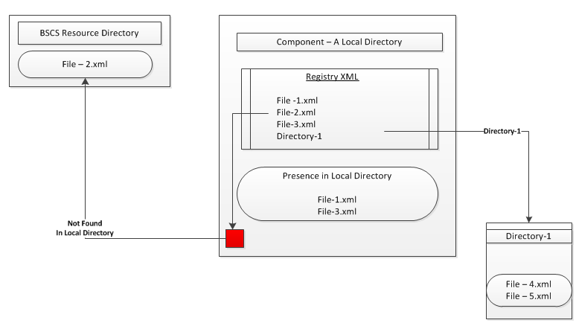
Registry configuration
Common Registry File – mainly frame work and server related
FUNC_FRMWK_CMN_Registry.xml
FUNC_FRMWK_SRV_Registry.xml
FUNC_FRMWK_SRV_DB_Registry.xml
Some More ….
Main registry can have link of “Directory” – all XML will be loaded by frame work of the directory
During loading – all entries (File specification) belong to registry are considered by following navigation
First component directory
Parent directory ($BSCS_RESOURCE).

Slide 6

Registry configuration
Structure of Main registry
Structure component registry
The root element <ComponentRegistry> contains following element
Node
KeyValue
Node: Section / directory in the registry tree with single attribute which is “name”
<Node name=“myNode”>
KeyValue: Leaf of registry tree with three attribute
Key
Type (Boolean / Float / Integer / String / Date)
Value
Comment

Slide 7
SOI component – naming service
Offers Tree – Directory structure for the object reference
Till BSCS R2, CORBA agent was Microsoft VisiBroker. Broker token use to work within the LAN over TCP/IP – Fails to call SOI API over HTTP
R3 onwards, CORBA agent is replace to “TAO Naming Service” to wok over HTTP
The URL of naming service - <Host Name>:<Port>/<Naming Service Name>
The complete qualifier of NS access
ORB use to get the CORBA service using objet reference [ORBInitRef]
Works uder IIOP (Internet Inter-ORB Protocol)
org.omg.CORBA.ORBInitRef=NameService=corbaloc:iiop:billtest:19000/NameService

Slide 8
SOI component – naming service
SOI servers are registered into Naming Service as <Server Name> and <Version>
All SOI servers are registered into private area of naming service – “com/lhs/private/soi”
Federated factory is registered in public section of naming service – “com/lhs/public/soi” which should not be crawled
Federated factory scans the Naming Service for SOI server and registered in its’ own space.
Multiple Federated Factory can run simultaneously with different name.
Each Federated factory linked with one security server which is mostly CMS in our case.
Local registry for configuration – Registry_FF.xml

Slide 9
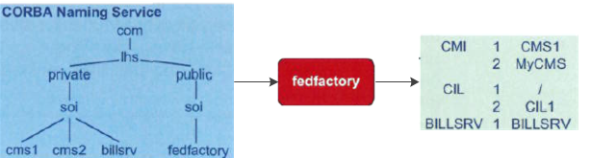
SOI component – naming service
FF (Federated Factory) start look up the Naming service to find SOI reference
FF build a local map. From the MAP FF can come to know the version of SOI component offered by the SOI server registered into the naming service.
Web client logs into FF and ask for the proper version of component
FF checks the MAP and return the proper component reference
Upon receiving the reference web client can connect to the SOI and start interacts.

Slide 10
SOI component – integration
SOI component offers business logic as SOI commands which are called by client
Each SOI component / servers maintain two mandatory directories which are
$BSCS_RESOURCE/<component>/soi :: define the component version with associated command
$BSCS_RESOURCE/<component>/cdf :: listed all the commands to define the input and output of each command under the version
All SOI components along with the version is registered in the CIL configuration file
CIL exposes one SOI which integrates other SOI(s).
CIL is implemented as plug-in of CMS hence it is not identified as separate server in Naming Service registry.
It starts and stop along with CMS
Command Scheduler (SCS) is plug-in of CIL

Slide 11
SOI component – integration
Each and every SOI components are registered in CIL registry @ $BSCS_RESOURCE/jcil/plugin/Registry_CIL_SOI.xml
Under main tag <ComponentRegistry> there are different nodes
“SOIDefinitions” :: Define the different version of CIL component
“CDFAltComponents” :: Define all SOI component under specific CIL version
<Node name=“SOIDefinitions”>
<KeyValue key=“CIL_7.xml” value=“”/>
<KeyValue key=“CIL_6.xml” value=“”/>
</Node>

Slide 12
SOI component – integration
“CDFAltComponents” :: Define all SOI component under specific CIL version
<Node name=“CDFAltComponents”>
<Node name=“CIL:7”>
<KeyValue key=“cms/soi/CMI_7.xml”
value=“cms/cdf” type=“String” comment=“…..”/>
<KeyValue key=“billsrv/soi/BSI_4.xml”
value=“billsrv/cdf” type=“String” comment=“…..”/>
</Node>
<Node name=“CIL:6”>
<KeyValue key=“cms/soi/CMI_6.xml” value=“cms/cdf” type=“String”
comment=“…..”/>
</Node>
</Node>

Slide 13
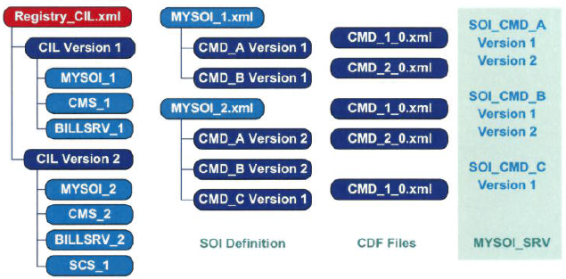
SOI component – integration
In CIL registry file there is one node for each CIL version and under that all SOI definition files are deployed with specific version.
Flexibility allows to register customized SOI definition in existing CIL layer so that plugin SOI components API become easily exposed with other SOI command uniformly.

Slide 14
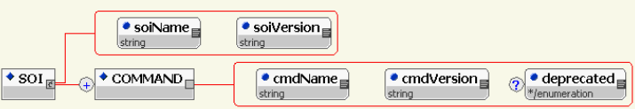
New SOI component
Develop new CORBA server and register into Naming Service
Implementing the SOI interfaces – Service Adapters
Creating SOI Definition File
There has to be one SOI Definition file / SOI version
An SOI version aggregates the command version that the SOI version supports
SOI definition file is stored in “soi” directory under the component root directory created under $BSCS_RESOURCE
File structure

Slide 15
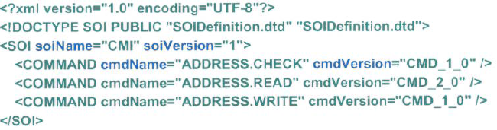
New SOI component
Root Element:
<SOI> having attributes
soiName :: Name of SOI component
soiVersion :: SOI version
<COMMAND> nested tag of <SOI> to list all commands. Empty tag with following attributes
cmdName :: Name of command
cmdVersion :: Command Version
Note: It is not necessary that SOI and command version need to be identical

Slide 16
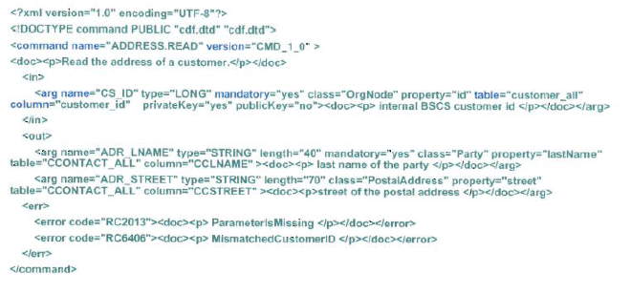
New SOI component
Creation of command definition file
XML file
Contains :: Command Name along with input, error code and output
Root Element :: <command> contains
<in> Element :: Declare the list of command input. Degree = Multiple
<out> Element :: Declare the list of output. Degree = Single
<err> Element :: Declare list of all possible error code. Degree = Multiple

Slide 17
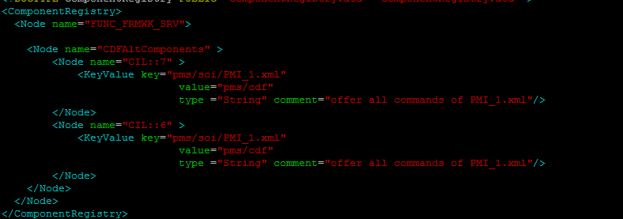
New SOI component
Adding SOI server / component in CIL
Create one directory by component name like “sample” under $BSCS_RESOURCE
New server expose this component
Under component directory there will be bare following directory
$BSCS_RESOURCE/<component>/soi : SOI Definition file will be kept under this directory
$BSCS_RESOURCE/<component>/cdf : Command definition files will be kept under this directory
$BSCS_RESOURCE/<component>/plugin : Component specific XML to register the new component under proper version of CIL

Slide 18
New SOI command
CIL is the single layer to expose interfaces of all SOI servers in uniform way, ensuring single client framework.
SOI server offers two type of commands which are
Fine-Grained
More than one of these commands might be required within one transaction to complete a business process.
Implemented in SOI server.
New command / business logic can be developed and integrated with new. developed SOI server.
Can be plugged-in to existing component and exposed through CIL
Coarse-Grained
Composite command. Used to handle the business case where unit of work or a single transaction comprises of multiple Fine-Grained commands.
Configured via configurable files without any sorts of development

Slide 19
Fine-grained command
Fine-Grained SOI command is registered in the server as “Domain Service Adapter”
Business logic of each command is an instance of “DomainServiceAdapter” – an interface of SOI frame work.
The adapter class need to be bind with COMMAND and COMMAND Version by invoking the static function “registerImplementation()” of “ImplementationRegistry” class
try{
ImplementationRegistry.registerImpelmentation(<Command Name>, <Command Version>, <this :: the instance of the class>
}catch(InconsistentRegistryException E){}
Need to override the superclass function “execute”
public void execute (ServiceContext Scon, String Arg1, String Arg2, SVLObject in,
SVLObject Out
Throws two exceptions
CommandVersionNotSupportedException
ComponentException

Slide 20
Fine-grained command
Override the “execute” function
public void execute (ServiceContext Scon, String Arg1, String Arg2, SVLObject in,
SVLObject Out) throws CommandVersionNotSupportedException, ComponentException
Arg1:: Command Name
Arg2:: Command Version
In:: The input parameter as instance of SVLObject
Out:: The output of command as instance of SVLObject
SVLobject is the wrapper class of CORBA native data type NVElementListI. It hides all sorts of CORBA specific technical details from developer and provide a name & value pair container with enhanced interfaces.

Slide 21
Fine-grained command
SOI framework uses the concept of OR Map (Object relational mapping) to have persistence service object (A bean class) for each DB Obejcts – Table / View
Till R3 top-link was used now “EclipseLink” is used as it is an open source to avoid license cost.
EclipseLink establish the connectivity with Oracle over JPA (Java persistence API)
New command will be registered in CMI component as new server / component is outside the scope
When CMS server starts up it establishes the connection pool with Oracle through EclipseLink and stored into transaction context.

Slide 22
Fine-grained command
Retrieve the “UnitOfWork” from the current instance of “Transaction Context”
UnitOfWork U_O_W = TransactionContext.getCurrent().getUnitOfWork()
Prepare the query object
Read Object :: DataReadQuery (Used for read only purpose - SELECT)
Modify Object :: DataModifyQuery (Used for updates – INSERT / DELETE / UPDATED)
Both the Query objects accepts one argument which – SQL String
Instance of “UnitOfWork” executes the query
U_O_W.executeQuery(String arg1, Vector arg2)
arg1 :: SQL statement
arg2 :: The arguments to pass the dynamic value
First create the Data Query objects
DataReadQuery rQuery = new DataReadQuery([Select Statement])
OR
DataReqdQuery rQuery = new DataResdQuery()
rQuery.setSQLString ([SQL Statement])

Slide 23
Fine-grained command
Create the argument vector
Vector <object> argList = new Vector <object> ();
Bind the Vector with Query for argument
<Data Query Object>.addArgument(<Argument Name>)
Insert the value into the argument vector
<Argument Object>.add(<Value>) ….. Note Value will be in String object
Example
UnitOfWork U_O_W = TransactionContext.getCurrent().getUnitOfWork();
DataModifyQuery D_M_Q = new DataModifyQuery();
D_M_Q.setSQLString(<SQL Statement>)
D_M_Q.addArgument(<Arg1>)
argList.add(<Value>)
D_M_Q.addArgument(<Arg2>)
argList.add(<Value>)

Slide 24
Fine-grained command
Execution of Read Only Query
Create a list of “Record” class of “Eclipse Link” persistence framework
List <Record> resultCollection = (List <Record>) U_O_W.executeQuery( <Data Query Object>, <argument Object>)
Iterate the resultCollection and access each “Record” object
Execution of Update Query
No output
Execute the query by instance of UniOfWork
Commit and Save the change
U_O_W.commitAndResume();

Slide 25
Fine-grained command
Libraries to import
General (Refer standard JAVA documentation)
java.util.Date;
java.util.List;
java.util.Vector;
java.util.logging.Logger;
Eclipse Link (Refer Eclipse Link Open source documentation)
org.eclipse.persistence.queries.DataModifyQuery;
org.eclipse.persistence.queries.DataReadQuery;
org.eclipse.persistence.sessions.DatabaseRecord;
org.eclipse.persistence.sessions.Record;
org.eclipse.persistence.sessions.UnitOfWork;

Slide 26
Fine-grained command
Libraries to import
SOI Framework
com.lhs.ccb.common.soi.SVLDate;
com.lhs.ccb.common.soi.SVLObject;
com.lhs.ccb.func.ect.ComponentException;
com.lhs.ccb.sfw.application.CommandVersionNotSupportedException;
com.lhs.ccb.sfw.application.DomainServiceAdapter;
com.lhs.ccb.sfw.application.ImplementationRegistry;
com.lhs.ccb.sfw.application.InconsistentRegistryException;
com.lhs.ccb.sfw.application.ServiceContext;
com.lhs.ccb.sfw.domain.TransactionContext;

Slide 27
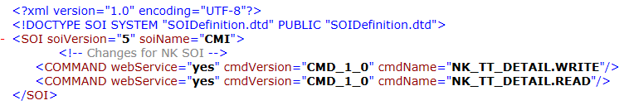
Fine-grained command
Command Deployment Outline
Deploy under CMI
Create the SOI declaration file under $BSCS_RESOURCE/cms/soi/CMI_NK_CMD_1.x ml>
SOI Declaration [Sample]
Command definition
Create two directories under $BSCS_RESOURCE/cms/cdf by following name. Each directory will contain the respective command definition
NK_TT_DETAIL_WRITE
NK_TT_DETAIL_READ

Slide 28
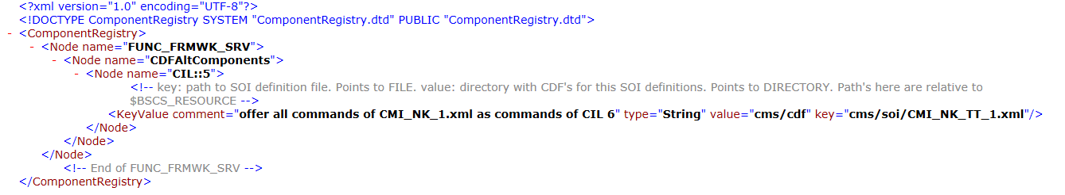
Fine-grained command
Register the NK command in CIL registry against a particular version
Create a configuration XML [Registry_NK_TT_CIL_SOI] under “plugin” directory of “jcil”

Slide 29
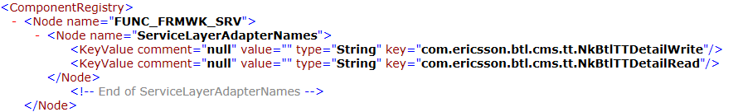
Fine-grained command
Register command adapters into the server so that component can recognize the Command vs. Adapter Class mapping.
Here no new server will be created – New server creation is out of scope
CMS server and CMI component will be used to register all the NK commands adapters.
Create “plugin” directory under $BSCS_RESOURCE/cms.
Create the component registry - “Registry_CIL_SOI_NK_TT” under the plugin directory
Main registry file of CMS link this directory – during server startups all the XMLs (Configuration files) of linked directory are read by CMS

Slide 30
Dynamic sql
Existing connection object is retrieved from Transaction context to execute the SQL query.
For simple development no OR mapping is used – instead direct DML statements are fired.
All SQL statements are example of JDBC prepare statement – A statement with bind variable which are replaced during execution.
Queries can be directly used or separately maintained outside the code block is configurable XML file – which are parsed and loaded by the server.
Each query is registered as an individual <Node> under <ComponentRegistry>

Slide 31
Dynamic sql
Sample Declaration of SQL Query in Registry.
<ComponentRegistry>
<Node name=“MySQL”>
<Node name=“sqlQueries”>
<KeyValue comment=“” value= “Select * from Customer_All where Customer_Id = #Cust_id” type=“String” key=“My_Select”/>
</Node>
</Node>
</CompoentRegistry>
Server loads all key-value pair information into hash map by framework.
In component registry parent node can have another child as sub node.
Sub-Node can have multiple key-value pair.
To get the value of a key, parent and sub node is necessary to search
“Registry” is a single tone class of the frame work which creates only one instance

Slide 32

Dynamic sql
Instance of “Registry” class, retrieves the parent node as an instance of “RegistryNode” by calling “getNode() function.
Child node is retrieved with the reference of parent node
Function “listEntries” of child node (Here adapterNode) returns the array of “RegistryEntry” class object to hold all the entries of key-value pair within the child node
The class “RegistryEntry” has two functions
getKey() :: Returns the key
getVaue :: The value of the key

Slide 33

Dynamic sql
Iterate the array and put into the map
Retrieve the SQL string from the map against the key “My_Select”
String sqlStatement = listvalue.get(<Key>).toString();
Information declared under <ComponentRegistry> loaded by server is maintained and accessed by following framework classes
com.lhs.ccb.func.reg.Registry;
com.lhs.ccb.func.reg.RegistryEntry;
com.lhs.ccb.func.reg.RegistryNode;

Slide 34
Composite command
No Development – setup via XML configuration.
Composites commands must be of same SOI version.
Duplicate SOI commands with a composite command is forbidden
Composite commands are exposed from CIL layer
Create folder by name of command under the “cdf’ directory of jcil
$BSCS_RESOURCE/jcil/cdf
Inside the folder created the command definition file
CMD_1_0.xml
This CDF will have the names of the different BSCS out-of-box SOI commands/APIs which needs to be combined into a single transaction
These commands will be mentioned inside the <in> tag.
The command for which the output parameters are expected in the response, they will be mentioned inside the <out> tag.

Slide 35
Composite command
Composite command needs to be registered into the JCIL which will have same version as the one is mentioned in “soiVersion” of <cmdref_base> tag in the CDF.
$BSCS_RESOURCE/jcil/soi
This new composite command now acts as a SOI command which will execute all the SOI commands mentioned inside its CDF as a single transaction.
Sample JCIL SOI Definition for composite command

Slide 36
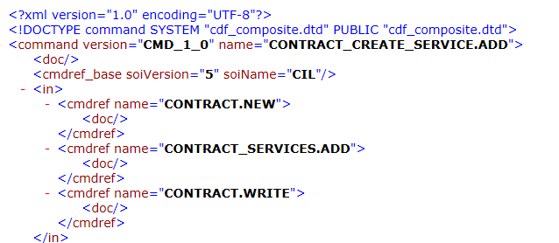
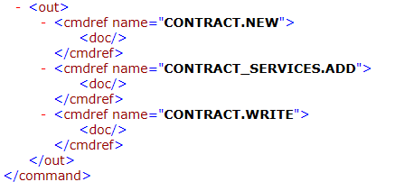
Composite command
Sample Command Definition File

Slide 37
Command access right
SOI commands are also considered as modules in billing system.
Separate module will be created for each SOI command with following parameters
This module will be declared in as child of parent module “CMSCMDS” in module hierarchy
Table Name | Attribute | Value
MODULES | MODULE_NAME | Any Module Name (NKCMD1)
MODULES | MODULE_NUMBER | -1
MODULES | DESCRIPTION | Command Name
MODULES | PERM_CODE | Command Name
MODULES | SOI_COMMAND | X
MODULES | MAX_USER_RIGHTS | W
MODULES | ACTIVE_INDICATOR | 1
MODULES_HIERARCHY | PARENT | CMSCMDS
MODULES_HIERARCHY | CHILD | Command Name
MODULES_HIERARCHY | GRPPERM | 2147483647

Slide 38
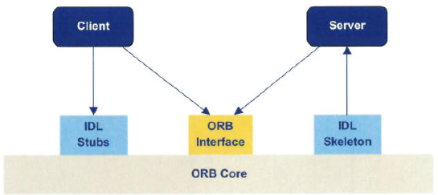
SOI Client development
SOI client is an instance of CORBA client which implements the SOI interface and executes the SOI Commands.
It provides a layer between SOI server and external application.
As standard CORBA implementation Client and Servers communicates through STUB and SKELETON
Pre-compiled stub and skeleton is part of shipment and comes under “soi.jar”

Slide 39
SOI Client development
Steps to-be followed
Initialize helper class
Initialization of ORB (Object Request Broker)
Implement Server Lookup and Login
Initialize the Business Unit
Execute the command
Disconnect from server
Initialize the helper class
Instantiate the “ExchangeFormatFactory”
ExchangeFormatFactory.init(new DefaultSVLObjectFactory);
Used to retrieve the SOI entry point
Used to create all SVLObjects
Register the parameter list into “ServiceLayerIntrospector” to load the input and output parameter values from CDF.

Slide 40
SOI Client development
Initialize the ORB
Before ORB initialization, all properties value of “orb.properties” need to be loaded into System properties
Create new properties object
Properties orbProp = new Properties();
Read orb.properties file
InputStream orbStream = ClassLoader.getSystemResourceAsStream( “orb.properties”)
Load the input stream into property object
orbProp.load(orbStream);
Load orb.properties into System properties
System.getProperties.putAll (orbProp);
Initialize the ORB with the configuration parameter of orb.properties
CORBAAdapter.instance().initORB(null);
 Note :: CORBAAdapter is a single tone class of common framework.

Slide 41
SOI Client development
Server Look up and connect
Initialize the naming service
NamingContextExt iniNameContext = CORBAAdapter.instance().getInitialNamingContext();
Find the CORBA object from the naming service
Object corbaObject = CORBAAdapter.instance().findCorbaObject(iniNameContext, TARGET_SERVER)
[ TARGET_SERVER is a macro to hold the value of federated factory in the registry of naming service
“com/lhs/public/soi/fedfactory1”
Get the service root of federated factory from the naming service
RootAccessor serviceRoot = ExchangeFormatFactory.instance().createRootAccessor (corbaObject)
Login to the server by user name and password.
Credential is checked by security server registered in the federated factory and returns the access
AccessorFactory _accessFactory = serviceRoot.login(<UID>, <PASSWD>, null);
Get the client session object to access the services of CIL for specific version
ServiceAccessor _servAccessor = _accessFactory.getServiceAccessor(“CIL”, <version>)
 Note :: Now ServiceAccessor object “_servAccessor” is ready to execute any command
Initialize the Business unit (execute “SESSION.CHANGE”) – is the first command to execute after having the session handle.
This command is used to set different session variable – mostly used to set the Business Unit

Slide 42
SOI Client development
Execute SESSION.CHANGE to set the BU-ID
It accepts the different configuration parameters as “name-value” pair in list.
Create the SVLObject
SVLObject inp = ExchangeFormatFactory.instance().createSVLObject();
Create SVLObject List
SVLObjectList list_inp = ExchangeFormatFactory.instance().createSVLObjectList();
Set the list against the “values” [ The input which hold the list of different configuration parameter ]
Inp.setValue (“values’, list_inp);
For each parameter create different instances of SVLObject.
SVLObject BUID = ExchangeFormatFactory.instance().createSVLObject();
Set the value BU-ID
BUID.setValue(“BU_ID”, “2”);
Add this SVLObject into the list
List_inp.add(BUID);
Execute the command to initialize the Business Unit
_servAccessor.execute (“SESSION.CHANGE”, inp);

Slide 43



SOI Client development
Development Outline
Import generic library
Import CORBA library
Import common framework library

Slide 44
SOI Client development
Create one client class with following skeleton
public class TestClient {
// Declare following static variables
protected void init () {
// Statements for ORB initialization, refer previous slide
}
public void connect () throws ComponentException {
// Statements for Server look up and login
// Retrieve the service accessor
}
public void initializeBusinessUnit( String pBuId) throws ComponentException {
// Statement for Business Unit initialization
// Execution of SESSION.CHANGE (Refer previous Slides_
}
} // Completion of client class

Slide 45
SOI Client development
Instantiate the client class within main function
public static void main (String [ ] args)
{
try
{
// instantiate the client class
TestClient tClient = new TestClient ( );
// initialize the ORB
tClient.init();
// Login to server
tClient.connect();
// Execute the Command
_serviceAccessor.execute (<Command Name>, <Input>)
// Save and commit the changes
_serviceAccess.commit();
// Disconnect of service accessor from point of connect
_serviceAccessor.dispose();
_accessorFactory.dispose();
}
catch (Exception E) { }
}

Slide 46
Web - interface
Client Frame Work (CFW)

Slide 47
Web - interface
Composition CX
Functional Level
Supported functionalities
Conceptual Level
Model – View – Controller (MVC2) architecture
Solution unit concept (Each business case)
GUI – Presentation Layer
Composition of JSP pages comprises of customized TAGs offered by CFW
Note :: Comparing to MVC1 architecture MVC2 is more complex. In MVC1, controller and model both are JSP. In MVC2 controller is servlet and model are java class.
Note :: MVC2 separates the logic from presentation layer while MVC1 does not.
Note :: In MVC2 architecture there is single servlet to receive all request and dispatch accordingly to respective model.

Slide 48
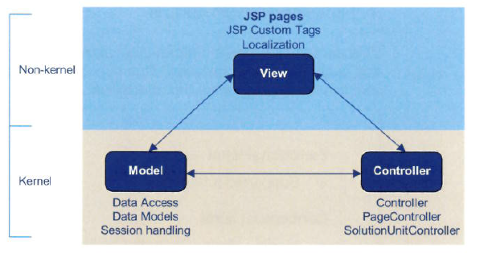
Web - interface
Basic MVC architecture
Among Model, View and Controller – Model and Controller belongs to Kernel Part and only View part belong to Kernel.

Slide 49
Client framework (cfw)
Model and controller belongs to kernel part. Changes only be done by DU. Files are sent in compiled form as jar with obfuscation
View belong to Non-Kernel part without Java coding effort. Views are in JSP
MVC framework comprises of three logical part
Model
Represents the Data Access area.
Provides the business data and business logic
Models notify when the view when it changes
Enables the controller the functionality encapsulated by the model
Controller
Dispatches user interaction
Accepts user input and map them into actions to be performed by model
View
Data presentation layers comprises of JSP pages.
It access the data from the model and specifies the way how data will be displayed
Forward the user input to controller for action

Slide 50
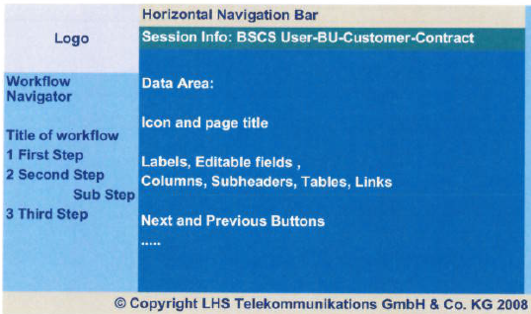
Web - interface
Presentation Layer
Logo
Vertical smart Navigation Pane
Horizontal Navigation Pane
Session Info
Data Area
Always accessible

Slide 51
Web - interface
Presentation Layer
Logo
In Multi company setup, LOG represents the branding of the company or Business Unit. LOGO can be replaced by configuration
Navigation Pane
Allows to access the solution unit (Different Business Cases)
Logical solution units are grouped together
Easy modification of SU caption
Easy to insert new solution unit
Horizontal Navigation Bar
Provides direct access of commonly non-functional pages like context help / tips
Always accessible
Session Info
Display session information persists throughout the session like Customer & Contract Info
Implemented through separate single JSP
Data Area
Different JSPs are appeared based one the selection of SU from Navigation Pane
This is the area where CX user works on

Slide 52
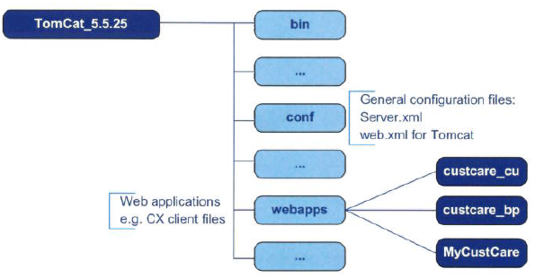
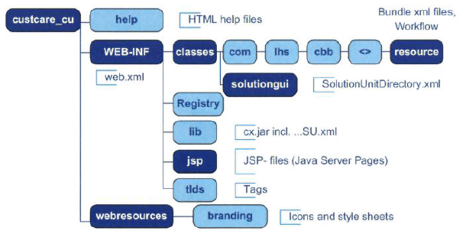
Web - interface
Tomcat Web Directory Structure
Customer Care Web-Interface Directory Structure

Slide 53
Web - interface
General Modification of CX interface
Related to general appearance of CX – Colors, Name of label and Menu item.
Customization can be done through the configuration file.
Modification of Data Area
Removing or adding new screen elements
Make the control Enable / Disable
Make the visibility of element On / Off
Make the element mandatory or optional
Cosmetic changes will be done in JSP file
Functional coverage
Remove / addition of new pages in the existing CX interface.
Remove / addition of new solution unit
Customization will be done through the configurable XML file

Slide 54
Web - interface
JSP Custom Tag
All controls of JSP page is based on custom tag with separate “.tld” (Tag library Definition)
CFW (Common framework) takes the responsibility to render the custom TAG into HTML page
JSTL (JavaServer page standard library) tags are used to incorporate the logical block with the custom tag instead of writing directly inside the JSP file
Sorts of encapsulation
Link the Control with Model attribute
Basic components of CFW
Solution Unit
Solution Unit Context
Solution Unit GUI
Solution Unit Controller
Page Controller
Resource Bundle
Workflow
Solution GUI Navigation Page Bundle

Slide 55

Web - interface
Solution Unit
Represent a use case like – Customer Creation / Search / Contract Creation / Search Etc.
For accomplishing the entire use case it may requires multiple JSP pages with logical sequence which is known as Work Flow
Work flow defined the execution of JSP page in a order based on the return value from page to page basis
Only one Solution Unit can be active at a
single point of time.
Solution units are considered and define in
billing system as modules in MODLUES table.
Solution GUI
It integrates available Solution Units.
It offers the Navigation page and as well as navigation, workflow option of each SU
Example
custcare_cu
custcare_bp
Each Solution GUI maintains single configuration file to mention all the Solution Units operable under the GUI

Slide 56
Web - interface
Solution Unit Controller
Responsible to identify the page controller for managing the data
Controls / manage the execution of Solution Unit steps defined in workflow
Responsible to handle the workflow-specific processing and business logic
According to the returned value from the page controller, solution unit controller prepares the page controller of the next step and also request for the JSP of next step
Workflow
One solution unit (Business use case) use to have single work flow
Define the JSP pages in sequence
Mention the Page Controller against each Pages
Page Controller
Prepare the data for the view
Return the value to SU controller to decide the next step
Performs the business logic
Two call back function “preparePage()” and “processPage()”
Data Model handling
Override above function to have specific functionality

Slide 57
Client framework (cfw)
CFW offers API to compose new solution unit and new pages.
Major role of client frame work
Web Specific Support
JSP pages represents the presentation layer
Data Model represents the persistence layer
Controller servlet manage request processing, presentation layer controlling and workflow handling
Solution Unit Support
Represents user specific task
Several solution units can be grouped together
All solution unit represents the full functionality of one Solution GUI (CX)

Slide 58
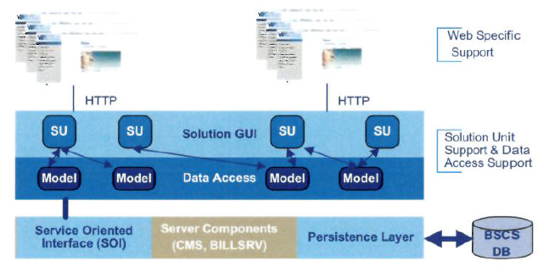
Client framework (cfw)
Major role of client frame work
Data Access Layer Support
Web client uses the SOI interface to communicate with component server
CFW introduces client side models (Data Model) and logical server session interface to provide the abstraction of server access.

Slide 59
Request processing
All requests are processed through servlets.
Different CFW servlets are used
StartupServlet
It performs application level initialization while web server is started.
Responsible to load the “SolutionUnitDirectory” where all SU(s) are registered
Responsible to load all the wokflow
SolutionGUIServlet :
Acts as front controller / first controller for a Solution GUI.
It is used only for initial request starting a solution unit
It is not required for processing within a specific SU
It forwards the request to “SolutionUnitServlet” which responsible to process the request
Maintains SolutionUnitContext in the HttpSession
SolutionUnitDirectory
A registry to define all solution units
SolutionUnitContext
A container to manage the information till the life cycle of one request i.e. the life cycle of one SU

Slide 60
Request processing
All requests are processed through servlets.
Different CFW servlets are used
SolutionUnitServlet
It is the front controller which directs the flow of activities in a solution unit
All Http requests from solution unit are addressed by this servlet
Does not perform SU related work
Forwards the request to solution unit controller which implements the logic of a specific solution unit
SolutionUnitController
Implemented for every solution unit which manage the navigation within the solution unit
It load the workflow. From work flow determines the page controller.
Control the workflow and determine the next step based on the return value of page controller
CFW provides the abstract implementation of controller class which is “AbstractSolutionUnitController”.
Page Controller
Associated with each page in the work flow
Returns value which decide the next step
Two major call back function “preparePage (Execute before displaying the page) and “processPage (Executes when any event is trigger from the page mainly button pressed). It returns value which is used by SU controlled to decide the next step from workflow

Slide 61
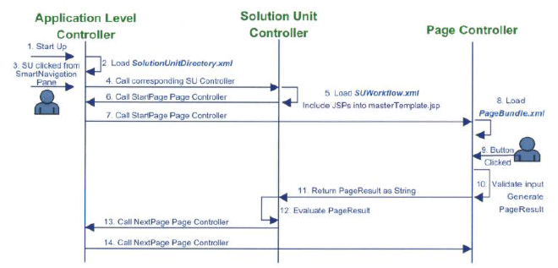
Request processing
Request Steps
Step-1: Tomcat is starting up, CX is loaded into web container
Step-2: StartupServlet loads SolutionUnitDirectory.xml and create SolutionUnitContext. If there is any change in this file web server need to restart to reflect the change
Step-3: End user clicks the SU from smart navigation pane
Step-4: SolutionGUIServlet delegates the request to SolutionUnitServlet which in turns call corresponding SolutioUnitController
Step-5: Solution Unit Controller load solution unit workflow file (.XML)

Slide 62
Request processing
Request Steps
Step-6: Solution unit controller passes the reference of the page controller to Solution unit servlet
Step-7: Solution unit servlet will call corresponding page controller
Step-8: Page controller load the resource bundle which hold the name of label of the page controls.
Step-9: End user clicks the button after filling up the controls
Step-10: Page controller validates the input and return the results
Step-11: Page result sent back to Solution unit controller as a sting
Step-12: Solution unit controller evaluates the result and compare it with the workflow configuration in order to determine the next page.
Step-13: Solution unit controller passes the references of page controller of next page to Solution Unit Servlet
Step-14: Solution unit servlet will call the page controller which is passed by Solution unit controller in previous step

Slide 63
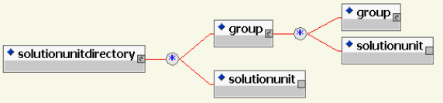
Frame work component
Solution Unit
Declare the Solution Unit in SU registry file (“SolutionUnitDirectory.xml”)
Solution units are displayed in Navigation Bar. The labels (Which will be displayed as menu option) stores in “SolutionGUINavigationPageBundle.xml”
Identify the node od navigation bar under which the option will be displayed
Different attributes of <solutionunit> tag
name (CDATA): Name of the solution Unit
id (ID): ID of solution Unit for reference
home(true / false): Default is “false”.
displaynavigationoption: “true”

Slide 64
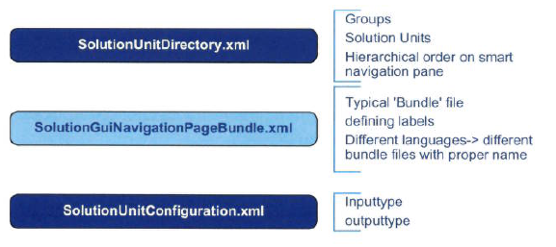
Frame work component
Solution Unit directory file is the central place to declare all the solution units under the following location
$CATALINA_HOME\webapps\custcare_cu\WEB-INF\classes\solutiongui
In this directory we have other two files – one for configuring the solution unit to link with controller and another is the resource bundle of navigation pane

Slide 65
Frame work component
Solution Unit Configuration
Further configuration file telling the input data to be available when entering the solution unit (inputtype) and data can be delivered (outputtype)
Link the solution unit with the controller
Controller class (servlet) is passed as “uri (Uniform Resource Identifier)”.
Solution Unit Servlet is called with the argument “ControllerName=<The Controller class>”
If no input type is specified that solution unit will be always displayed in navigation pane
“inputtype=“CustomerListModel”” means the SU will be accessible only after selecting a customer
“alias” is used to enable the same SU can be reused in different context with different resource bundle like
“PartyOverviewSU” is the example of single SU but used for two different purposes accessing two different alias which are “CustomerOverviewSU” and “PartyOverviewSU”

Slide 66
Frame work component
Solution Unit Label configuration
“SolutionUnitNavigationPageBundle.xml” is the resource file which contains the label of all solution unit which is displayed in smart navigation pane as menu option for case to case use case basis
<bundle version=“1.0”/>
<header creationdate=“08-10-2017” author=“R.Shingh”/>
<body>
<label key=“CustomerUpdateP2PSU”>
P2P Information
</label>
</body>
</bundle>
We can change the caption of existing menu option.
To configure any new SU we need to first configure these three files.
Declare the solution unit
($CATALINA_HOME/webapps/custcare_cu/WEB_INF/solutiongui/SolutionUnitDirectory.xml)
Configure the solution unit
($CATALINA_HOME/webapps/custcare_cu/WEB_INF/solutiongui/SolutionUnitConfiguration.xml)

Slide 67
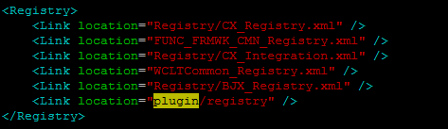
Frame work component
Solution Unit Label configuration
To configure any new SU we need to first configure these three files.
Define the SU label to be displayed as menu option in
$CATALINA_HOME/webapps/custcare_cu/WEBINF/solutiongui/SolutionGUINavigationPageBundle.xml
All these configuration can be made within the existing files where all kernel configurations exist or can be configured as CX “plugin” by creating under separate directory
All configuration and link of other directories mentioned in “Registry.xml” are loaded by CFW while web server startup
$CATALINA_HOME/webapps/custcre_cu/WEB-INF/classes/Registry.xml
Create new Registry file “NK_Registry.xml” to declare all adaptation specific configuration under “plugin/registry” directory

Slide 68
Frame work component
Solution Unit Label configuration
Create a directory under “plugin” by name of your business case like “P2P”
Create a directory under “plugin/P2P” by name “solutiongui”
Under “plugin/P2P/solutiongui/” creates all three configuration file.
From file “NK_Registry.xml” created under “plugin/registry” directory link the above directory

Slide 69
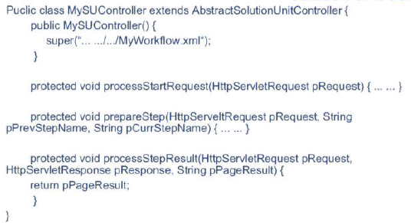
Frame work component
Solution Unit Controller
Manage step-by-step workflow management based on predefined configuration
To create own controller extends from CFW abstract class “AbstractSolutionUnitController”
Base class provides the basic functionality to manage the execution by overrdding generic function

Slide 70
Frame work component
Constructor
Called before instance initiation
Called the constructor of super class to pass the complete qualifier of “workflow configuration file”
processStartRequest ()
This method is called when solution unit is started
The purpose of this method is to implement the business logic and configuration which is required during the entire SU life cycle and also before the first page of workflow is accessible
The typical task to read the model identifier which is passed as “inputtype” of the solution unit
Another purpose to initiate the data model which will be used during the SU life cycle
prepareStep()
This method is used before request is sent to a certain page
processStepResult()
This method is called after page specific controller returns the page result
Can be used to overwrite the returned page result based on specific business logic
It allows to reuse same JSP Page and page controller implementation in different solution unit.

Slide 71
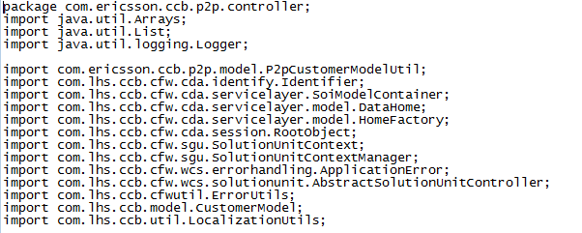

Frame work component
Solution Unit Controller
Extended from AbstractSolutionUnitController
Loads the workflow

Slide 72
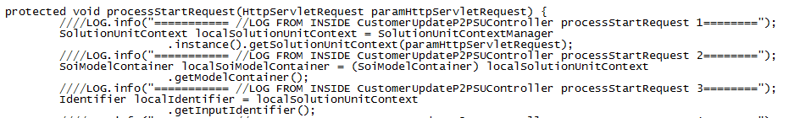
Frame work component
Solution Unit Controller
Overrides “processStartRequest”
Identify the solution unit context from HttpServletRequest
Retrieve the Data Container from Solution Unit Context
Retrieve the Data model from container
Retrieve the input identifier from SolutionUnitContext
If the Identifier is “CustomerListModel” the model class linked as input of SU then retrieve the “Data Home” of this Data Object by single tone class “HomeFactory”
From “Data Home” retrieve the actual instance “Customer Model” which passes as input from previous SU.

Slide 73
Frame work component
Solution Unit Controller
Overrides “processStartRequest”
Used to set the attribute value at Http Request level and Solution unit context level
protected void processStartRequest( HttpServletRequest pHttpServletRequest)
{
// Retrieve the solution unit context from HTTP request
SolutionUnitContext suContext = SolutionUnitManager.instance().gerSolutionUnitContext(pHttpServletRequest);
// Setting up the attribute value
pHttpServletRequest.setAttribute (<Attribute Name>, <Attribute Value>);
suContext.setAttribute (<Attribute Name>, <Attribute Value>);
}

Slide 74
Frame work component
Solution Unit Workflow
Workflow composed of several steps placed in logical sequence
First step with which a workflow starts is called “start step”.
A SU can have only one step within it.
Comprises of different segments
Header
creationdate: Date of creation
changedate: Date when the work flow is lastly modified
author: The creator of the work flow
Under single header for a workflow there are several steps.
Step
startstep: If the step is the starting step. For a SU there will be single start step. Possible values (true / false)
pagecontroller: Link the page controller for the step
stepname Name of the step
Under one step there is one screen definition to mention the JSP page and the link of different target steps against the return value of page controller

Slide 75
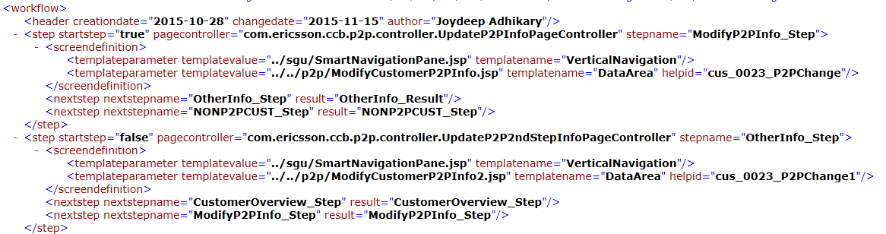
Frame work component
Solution Unit Workflow
Screen Definition
Under the <screendefinition> XML element there are <templateparameter> empty tag.
Multiple entries
Template Parameter
templatename: Name of template. Possible values are – “VerticalNavigation” (Left navigation Pane) and “DataArea” (To display the Page).
Next Step
nextstepname: Name of the next step
result: Result which is returned by the page controller.

Slide 76
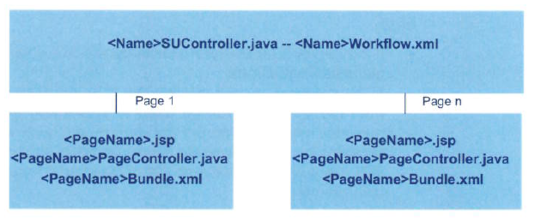
Frame work component
Solution Unit Workflow
Workflow is controlled by controller and workflow configuration file
Each solution unit is having single work flow for entire solution unit and also one workflow configuration file
Each step is composed with one JSP page, One Page Controller and one associated resource bundle to define the label of page element

Slide 77
Frame work component
Page Controller
Page Controller is associated with each JSP page
It access the model layer, solution unit context and HTTP request / response
It prepares the input data for the JSP page
Reacting against the user interaction such as
Caching the input value submitted in the HTML form of JSP page
Writing the input values to data model
Performing business logic / validation
Return the page result to solution unit controller to determine the next step from the defined workflow
CFW provides the abstract implementation of page controller which is “ExtendedAbstractPageController”
New page controller needs to be extended from above abstract page controller
Note: Page controller provided by LHS is the kernel page controller and cannot be changed. For new SU new page controller will be implemented
Note: Specific implementation is possible by overriding the “preparePage() and processPage()” function

Slide 78

Frame work component
Page Controller
It loads the resource bundle for the page
Create the null constructor which internally call the constructor of parent class “super()”
Override the method “getResourceBundleName” to return the resource bundle to attached
Resource bundle is stored in cx.jar
Load the resource bundle from page controller by mentioning the entire qualifier of resource bundle. Directory will be “.” sparated like
com.ericsson.ccb.p2p.resource.<Resource Bundle Name>

Slide 79
Frame work component
Page Controller
Override the following function for specific implementation
public void preparePage(HttpServletRequest pPrquest)
Method is call before the HTTP request forwarded to the JSP
Mainly used to include the required data model and property values into the request to JSP
Any business logic which is require to prepare the page is mentioned here
public void preparePage(HttpServletRequest pPrquest, HTTPServletResponse pResponse)
This method is called when the JSP is submitted
It is mainly used for page specific validation
Implement page specific business logic with input data and submit the information to model
It allows to return the value based on different events generated from different button
Most important task to return the value to decide the next step by SU controller

Slide 80
Frame work component
Page Controller
JSP page contains pre-defined standard buttons provided by the CFW
Standard JSP controls are not used.
Controls are defined by custom tag library
JSP is submitted while a button is pressed and “processPage” of page controller called.
CFW supported buttons are
Cancel Button
OK Button
Submit Button
Next Step Button
Previous Step Button
Finish Button
Reset Button

Slide 81
Frame work component
Page Controller
CFW provides following function to track which button is pressed
isCancelButtonPressed()
isOKButtonPressed()
isNextStepButtonPressed()
isPreviousStepButtonPressed()
isFinishButtonPrssed()
isResetButtonPressed()
isSubmitButtonPressed()
isButtonPressed(String pButton) [ If there is multiple submit button then we can track which button is pressed by this function passing the button name ]
From processPage() evaluate which button is pressed with the help of previous function and return different value.
Based on different value next step will be selected by SU controller

Slide 82
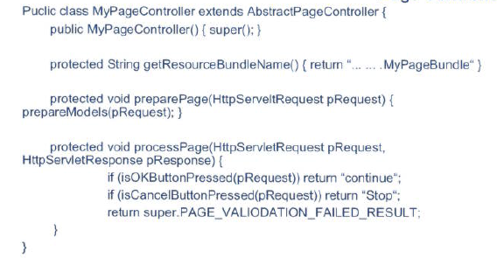
Frame work component
Inter Relation between configuration file
Page Bundle is registered in the “Page Controller”
“Page Controller” & “JSP” files are registered in the workflow
Workflow is registered in “Solution Unit Controller”
“Solution Unit Controller” is registered in Solution Unit Configuration File
“Solution Unit” is registered in the “Solution Unit Directory” file

